Slide 1

UNIT 3
SYLLABUS: Tools and Techniques for Quality Management
The seven traditional tools of quality – New management tools – Six sigma: Concepts, Methodology, DMAIC, applications to manufacturing, service sector including IT –Bench marking process

Slide 2
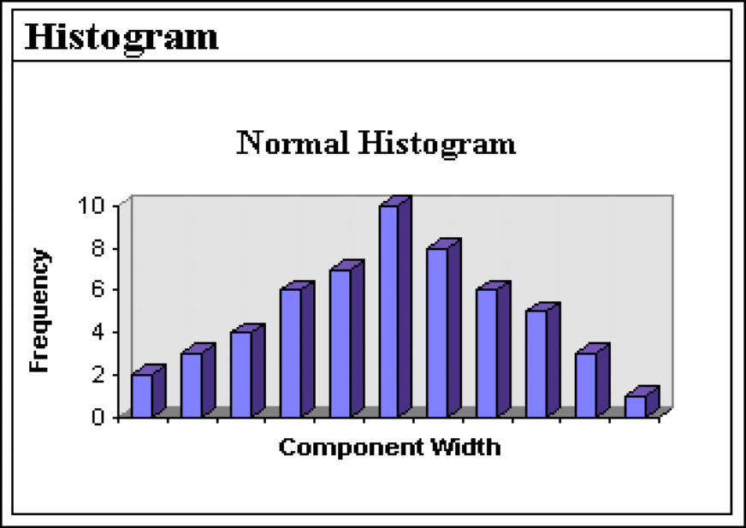
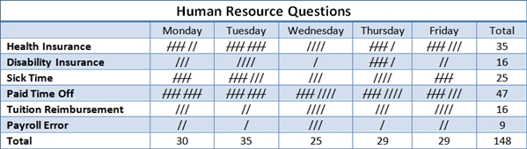
TOPIC 1:The seven traditional tools of quality
1.. Check Sheet
A check sheet is a simple form used for collecting and analyzing data systematically.
Uses
Collect defect data
Record frequency of problems
Easy data gathering
Example
Recording number of defective products produced each day.
2. Histogram
A histogram is a bar graph showing frequency distribution of data.
Uses
Understand variation
Identify process performance
Analyze distribution pattern
Example
Distribution of product weights in manufacturing.

Slide 3
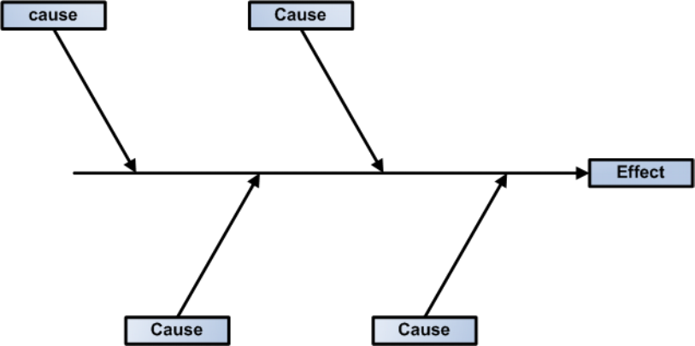
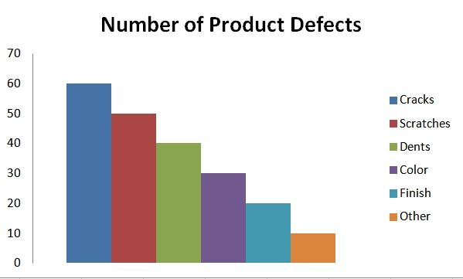
3.Ishikawa diagram (CO3)
Ishikawa diagram also known as a ,cause and effect diagram, fish-bone diagram shows the many possible causes of a problem.
To use this tool, you need to first identify the problem you are trying to solve and simply write it in the box (head of the fish) to the right.
4.Pareto chart (CO3)
Pareto Chart
Based on the 80/20 rule developed by Vilfredo Pareto. It shows major causes contributing to most problems.
Uses
Identify major defects
Prioritize problems
Improve decision making
Principle
80% problems are caused by 20% causes.
Example
Most customer complaints are due to late delivery.

Slide 4
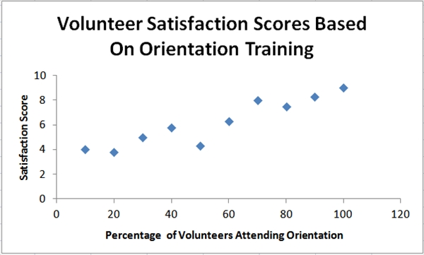
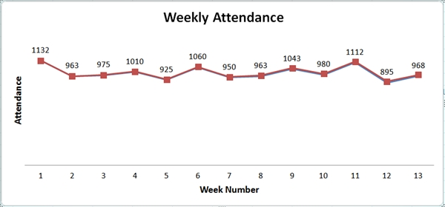
5.Scatter diagram
Shows relationship between two variables.
Uses
Identify correlation
Analyze cause-effect relationship
Example
Relation between training hours and employee performance.
6.Control chart (CO3)
Developed by Walter A. Shewhart. It monitors process variation over time.
Components
Upper Control Limit (UCL)
Lower Control Limit (LCL)
Central Line
Uses
Process control

Slide 5
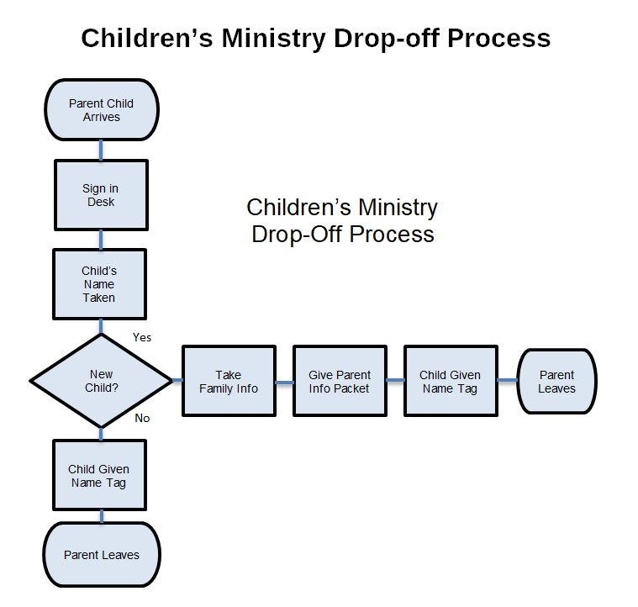
7.Flow chart (CO3)
A graphical representation of process steps.
Uses
Understand workflow
Identify bottlenecks
Improve process efficiency

Slide 6

TOPIC 2:New Management Tools
1. Affinity diagram: organizes a large number of ideas into their natural relationships.
2. Inter Relations diagram: Shows cause-and-effect relationships and helps you analyze the natural links between different aspects of a complex situation.

Slide 7
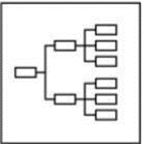
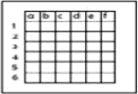
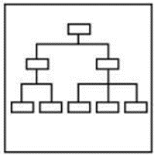
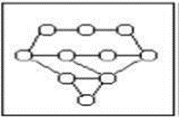
3. Tree diagram:Breaks objectives
into smaller tasks..
4. Matrix diagram: shows the relationship between two, three or
four groups of information and can give information about the
relationship, such as its strength, the roles played by various individuals,
or measurements
6. Arrow diagram: shows the required order of tasks in a project or process, the best schedule for the entire project, and potential scheduling and resource problems and their solutions
7.Process decision program chart (PDPC): systematically identifies what might go wrong in a plan under development. Identifies possible risks and countermeasures in a plan

Slide 8
TOPIC 3:SIX SIGMA
SIX SIGMA
This is quality improvement initiatives which include – Clear focus on achieving measurable and quantifiable financial returns from any project. etc. to lead and implement the Six Sigma approach.
At the heart of the methodology is the DMAIC model for process improvement. DMAIC is
commonly used by Six Sigma project teams and is an acronym for:
DMAIC - The basic methodology consists of the following five steps:
Define process improvement goals that are consistent with customer demands and the enterprise strategy.
Measure key aspects of the current process and collect relevant data.
Analyze the data to verify cause-and-effect relationships. Determine what the
relationships are, and attempt to ensure that all factors have been considered.
Improve or optimize the process based upon data analysis using techniques like Design of Experiments.
Control to ensure that any deviations from target are corrected before they result in defects. Set up pilot runs to establish process capability, move on to production, set up control mechanisms and continuously monitor the process.

Slide 9

SIX SIGMA
DMADV
The basic methodology consists of the following five steps:
Define design goals that are consistent with customer demands and the enterprise strategy.
Measure and identify CTQs (characteristics that are Critical To Quality), product capabilities, production process capability, and risks.
Analyze to develop and design alternatives, create a high-level design and evaluate design capability to select the best design.
Design details, optimize the design, and plan for design verification. This phase may require simulations.
Verify the design, set up pilot runs, implement the production process and hand it over to the process owners.
Implementation roles –
One of the key innovations of Six Sigma is the professionalizing of quality management functions. Prior to Six Sigma, quality management in practice was largely relegated to the production floor and to statisticians in a separate quality department. Six Sigma borrows martial arts ranking terminology to define a hierarchy (and career path) that cuts across all business functions and a promotion path straight into the executive suite.

Slide 10
TOPIC 4:BENCHMARKING
BENCHMARKING
"Benchmarking: A continuous, systematic process of evaluating and comparing the capability of one organization with others normally recognized as industry leaders, for insights for optimizing the organizations processes."
Benchmarking is the process of comparing organizational performance with best-performing organizations to improve quality and efficiency.
Types of Benchmarking
1. Internal Benchmarking
Comparison within same organization.
2. Competitive Benchmarking
Comparison with competitors.
3. Functional Benchmarking
Comparison with organizations having similar functions.
4. Generic Benchmarking
Comparison of general business processes.
Advantages of Benchmarking
Improves quality
Increases efficiency
Encourages innovation
Enhances customer satisfaction

Slide 11
STEPS IN BENCHMARKING
1. Planning
Identify process to benchmark.
2. Data Collection
Collect information from best organizations.
3. Analysis
Compare performance gaps.
4. Integration
Set improvement goals.
5. Implementation
Apply best practices.
6. Review
Monitor results continuously.

Slide 12
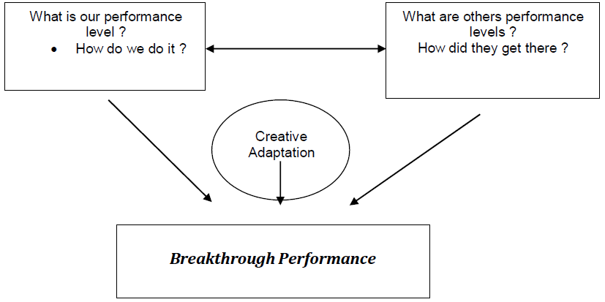
THE BENCHMARKING PROCESS
The formal 10-step benchmarking process is shown in outline below:
Identify the Process
Identify Benchmarking Partners
Determine Data Collection Method
Collect Data
Analyze Performance Gap
Identify Best Practices
Set Improvement Goals
Develop Action Plans
Implement Improvements
Review and Monitor Results
BENCHMARKING CONCEPT

Slide 13
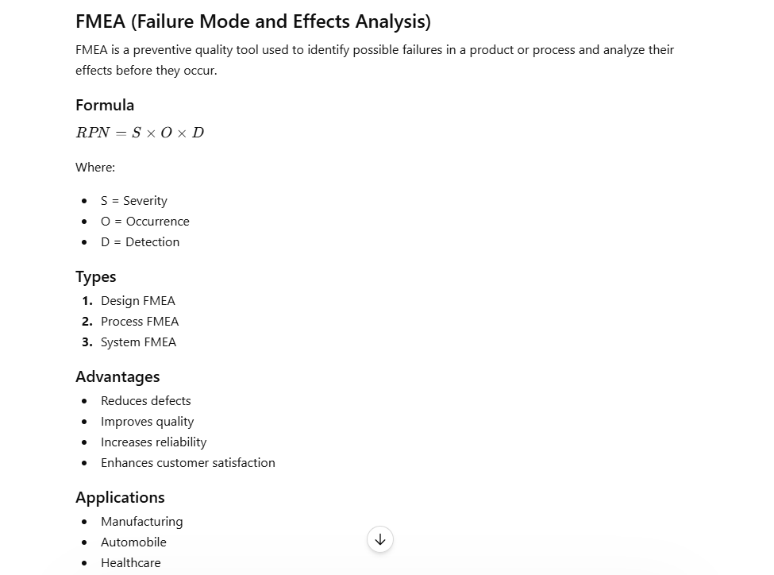
EXTRA TOPIC GIVEN THA

